Slide 1
ITE
HARI RAYA BRIEFING

Slide 2
Duty Raya
EN RICKY AJAN (24 JAM)
016-7218909

Slide 3
‑Troubleshooting Internet & Networking
INTERNET (STREAMYX)
NETWORKING (HUB/SWISH)
MY CLINIC
COMPUTER
PRINTER/FAX
DMS SYSTEM
TASKAD

Slide 4
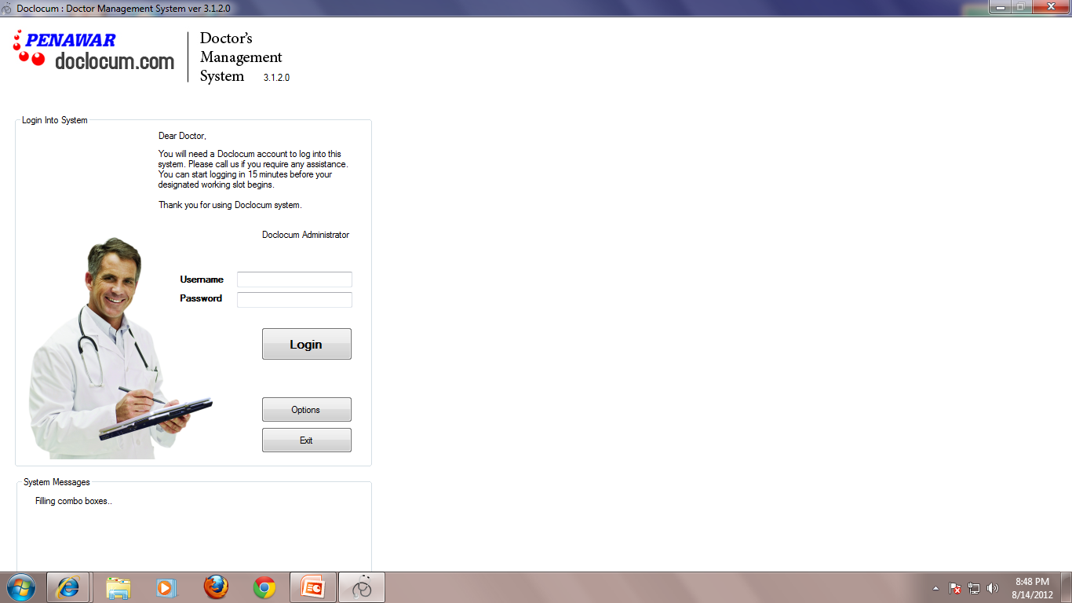
DMS system upgrade 3.1.2.0

Slide 5
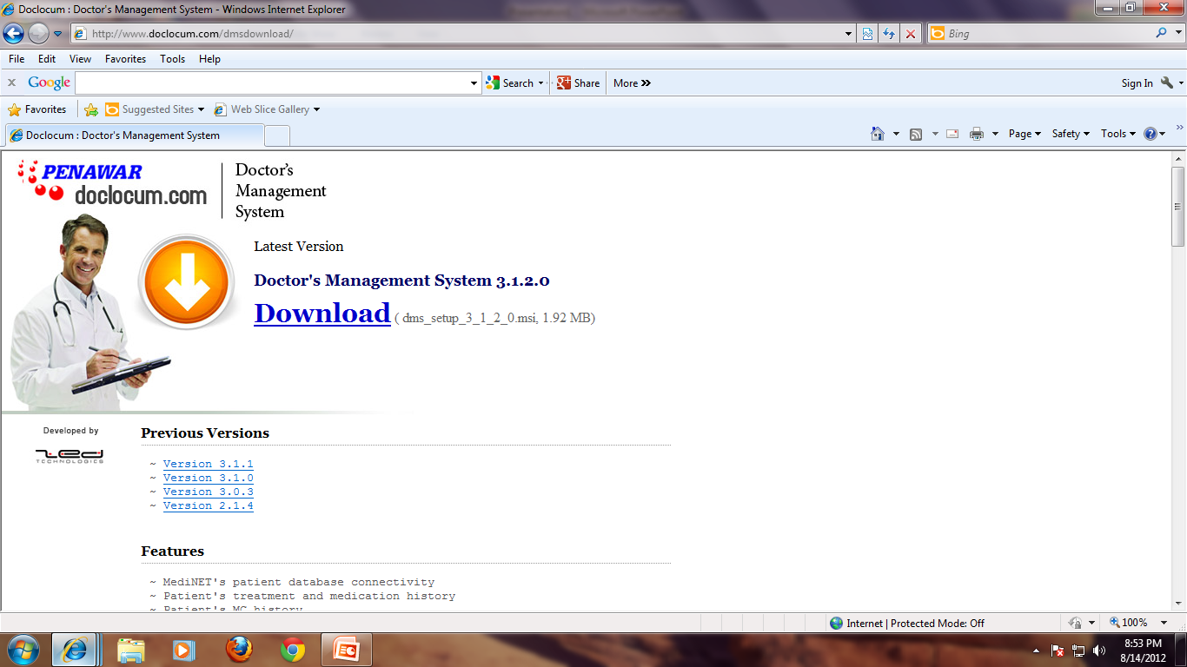
http://www.doclocum.com/dmsdownload/

